Slide 1
Educating from the Heart
Family of the Sacred Heart –a stamp, an imprint that brings us closer and links us

Slide 2
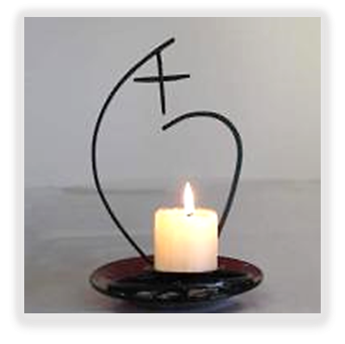
Mariola Lopez -Three areas explored:
The Heart – to be at one with God and with the stirrings of our own hearts
Interiority – General Chapter: Silence
Everyday Life – How we impact on
others

Slide 3

The rush and immediacy of everyday life?
We are living in a digital era-avalanche of information with an inability to be attentive to one another
Christian Bobin:
For me, the most important thing is the person I am face to face with, not the electronic gadget. You are the one I consider important…….
Sophie stated in a letter to Mother Goezt in 1862: “Even when we aim to do the right thing, we do it in a hurry, and all can be spoilt in this impulsive way of acting”.

Slide 4
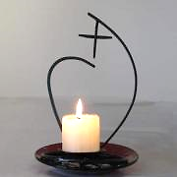
1. The Heart
To be present to others, we need to be present to ourselves
We are becoming experts on technology but are losing the keys to each other’s hearts…
Sophie used to say to her friends: “Take care of your heart because in there lies the source of life”……

Slide 5
The Pericardium
The heart has a membrane, which is the pericardium, This membrane wraps and protects it, holds it in place. It is also called “the guardian of the heart" and is its protective shield, guards the emotional memory of our experiences.
When we feel trust, confidence, pleasure, acceptance … the pericardium expands and we feel expansion, open, we breathe easily …

Slide 6
The Heart - Fear
In situations of dread, of judgment, all that makes us fearful, it shrinks and closes our pericardium … we close in us, and with time it can manage to harden the heart.
The first word that Adam says to God when he asks him where he is? “I was afraid … I was afraid and hid." (Gn 3, 10)
Fear shrinks our hearts and deprives us of joy, the major thief, the predator of our lives

Slide 7
The Heart -VALUE and TRUST
The mantra of Sofia and Philippine. The slogan that accompanied them in the distance- VALUE and TRUST. Good antidotes against the dread that paralyzes us and shrinks us.
When we can trust, when the "guardian of the heart", is free, flexible, open … we live from the LOVE that is our deeper nature. The sign that the well spring of the heart is opened is that it has a luminosity, a generous availability….

Slide 8
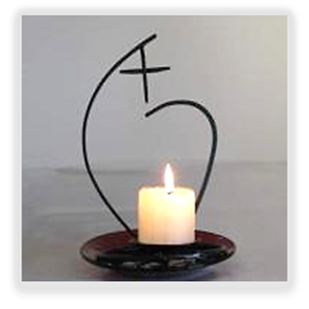
Touching people’s hearts
When we start getting in touch with our own hearts, or we allow others to connect with us, we discover how much warmth, sensitivity and space exists in our inner selves.
Janet Stuart: Enabling students to discover their inner life mission or purpose (telos)
The story of Camus and his teacher, Louis Germain
Sophie wanted to touch the heart of the girls. She used to say her sisters, "You must have a sincere and tender affection … It should be a love without weakness, without preferences or attention to appearances and exterior qualities. It will be a tender and delicate love, but also one that is noble, pure and unselfish."
This kind of love is essential in our educational mission, Aristotle said about to some who approached him, "I cannot teach anything to them, they do not love me "

Slide 9

2. Interiority
Janet Stuart in Japan
"It is very advantageous not to be oppressed all the time by competitiveness …but to have intermittent moments of relative solitude, in silence, complete freedom, even if you are not completely on your own..….”
“It is necessary to remember that each of the girls is assigned a mission in life. Neither we not they know what it is but we must help them discover their own mission and to value it”
The Chapter in 2016 is the call TO SILENCE, to go deeper into our interior life
To take care of this interior dimension as educators, we need to protect certain daily spaces for silence and to incorporate them into our everyday life.

Slide 10

Putting beauty in our mission
Obsession with performance, efficiency, aims, competition etc. versus calm, amazement, openness.
The really important thing is to take care of the student’s inner self, whole self, inner beauty, warmth, ability to offer shelter and nurturing to others. We need to nourish of it day after day
Real life is the “messy draft.”
It takes us time to discover that the one that God loves is the messy one that pains us, with all its blemishes. It is from this one and not a new one that will come unexpected blossoms.

Slide 11

3. Everyday life-The Perfume
Sophie told her Sisters:
“Remember that your presence reminds them of GOD.”
“Nothing works so powerfully in the spirit as example."
The educational mission is not on paper but in the little daily things lived by each person

Slide 12
Everyday Life-The Perfume
We teach more with what we are than with what we say.
What do we radiate everyday?
What perfume do we leave …?
People will forget what we have said and what we did, but they will never forget how we made them feel.

Slide 13

Our heritage from the first Sacred Heart educators
To discover the gift of every child and of every teacher and support them in order that they grow and develop this gift.
Philippine failed at English Language but she was outstanding at listening to the hearts of others, to their needs. She was distinguished at warmth of presence, taking care of others, in sharing happiness, in expressing gratitude
She transmitted with her presence much more than she managed to transmit with her words

Slide 14
Gratitude
To choose life in the educational mission has to do with choosing gratefulness and joy each day in the small things as well as the big things.
To choose to be grateful. The feeling of gratitude opens us up and spreads our ability to give and receive, to be rejoiced with the well-being of others
The major gift that a child can receive - or a teenager - is a happy educator. Sophie and Philippine wanted that the girls to be happy during their school days, “Hard work and joy” were “distinctive features in our way of educating”, as were: "happy discipline " , and the challenge of cultivating in the lessons an atmosphere of “encouraging joy ". (from Life in our Schools)

Slide 15

In all the daily learning we must not reserve any of the perfume but we must pour it generously.
In the spirit of Philippine we can strengthen our links as Sacred Heart educators crossing new borders, being creative in our ways of being present, making networks of justice and compassion woven with "tenderness and firmness " … that make it possible for every child could find their place in the world. What joy it is if they can leave school feeling that their lives are blessed and aware that they bring their gifts wherever they go

