Slide 1
Prayer Stations
St Joseph’s primary

Slide 2
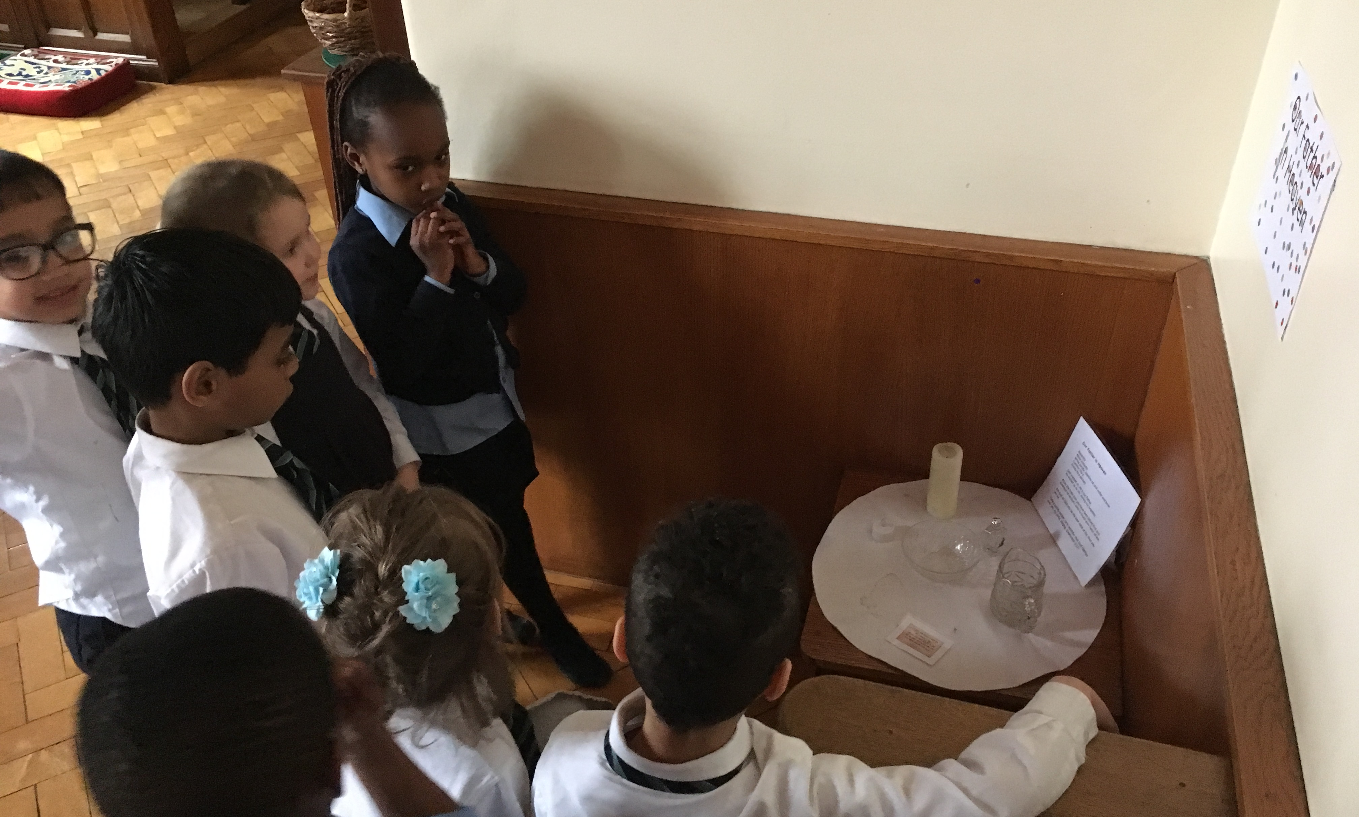
Prayer station in action

Slide 3
How Prayer Stations work.
7 – 10 prayer stations on a theme.
Children work their way around the stations, in small groups of 3/5 children.
Each group spends 3-5 minutes at each station.
Teacher can ring bell to indicate time to move onto the next station.
At end, stations need tidied – ie candles turned off, stones replaced etc.

Slide 4
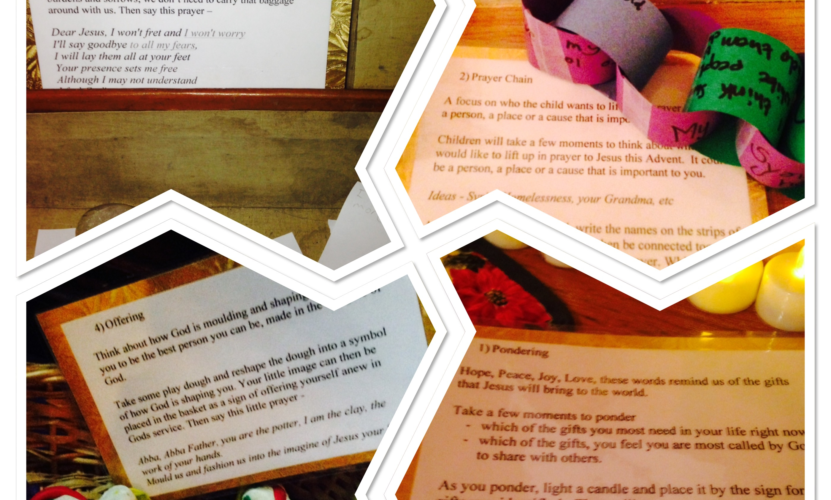
Advent Prayer Stations
Pondering/Wondering

Slide 5
How prayer Stations work
Each prayer station has an information card, that tells the group what to do.
It might have a verse from scripture.
Variety is the key, some they need to write, some they pray silently, whilst others ask them to touch, or eat something as they think on a subject.

Slide 6
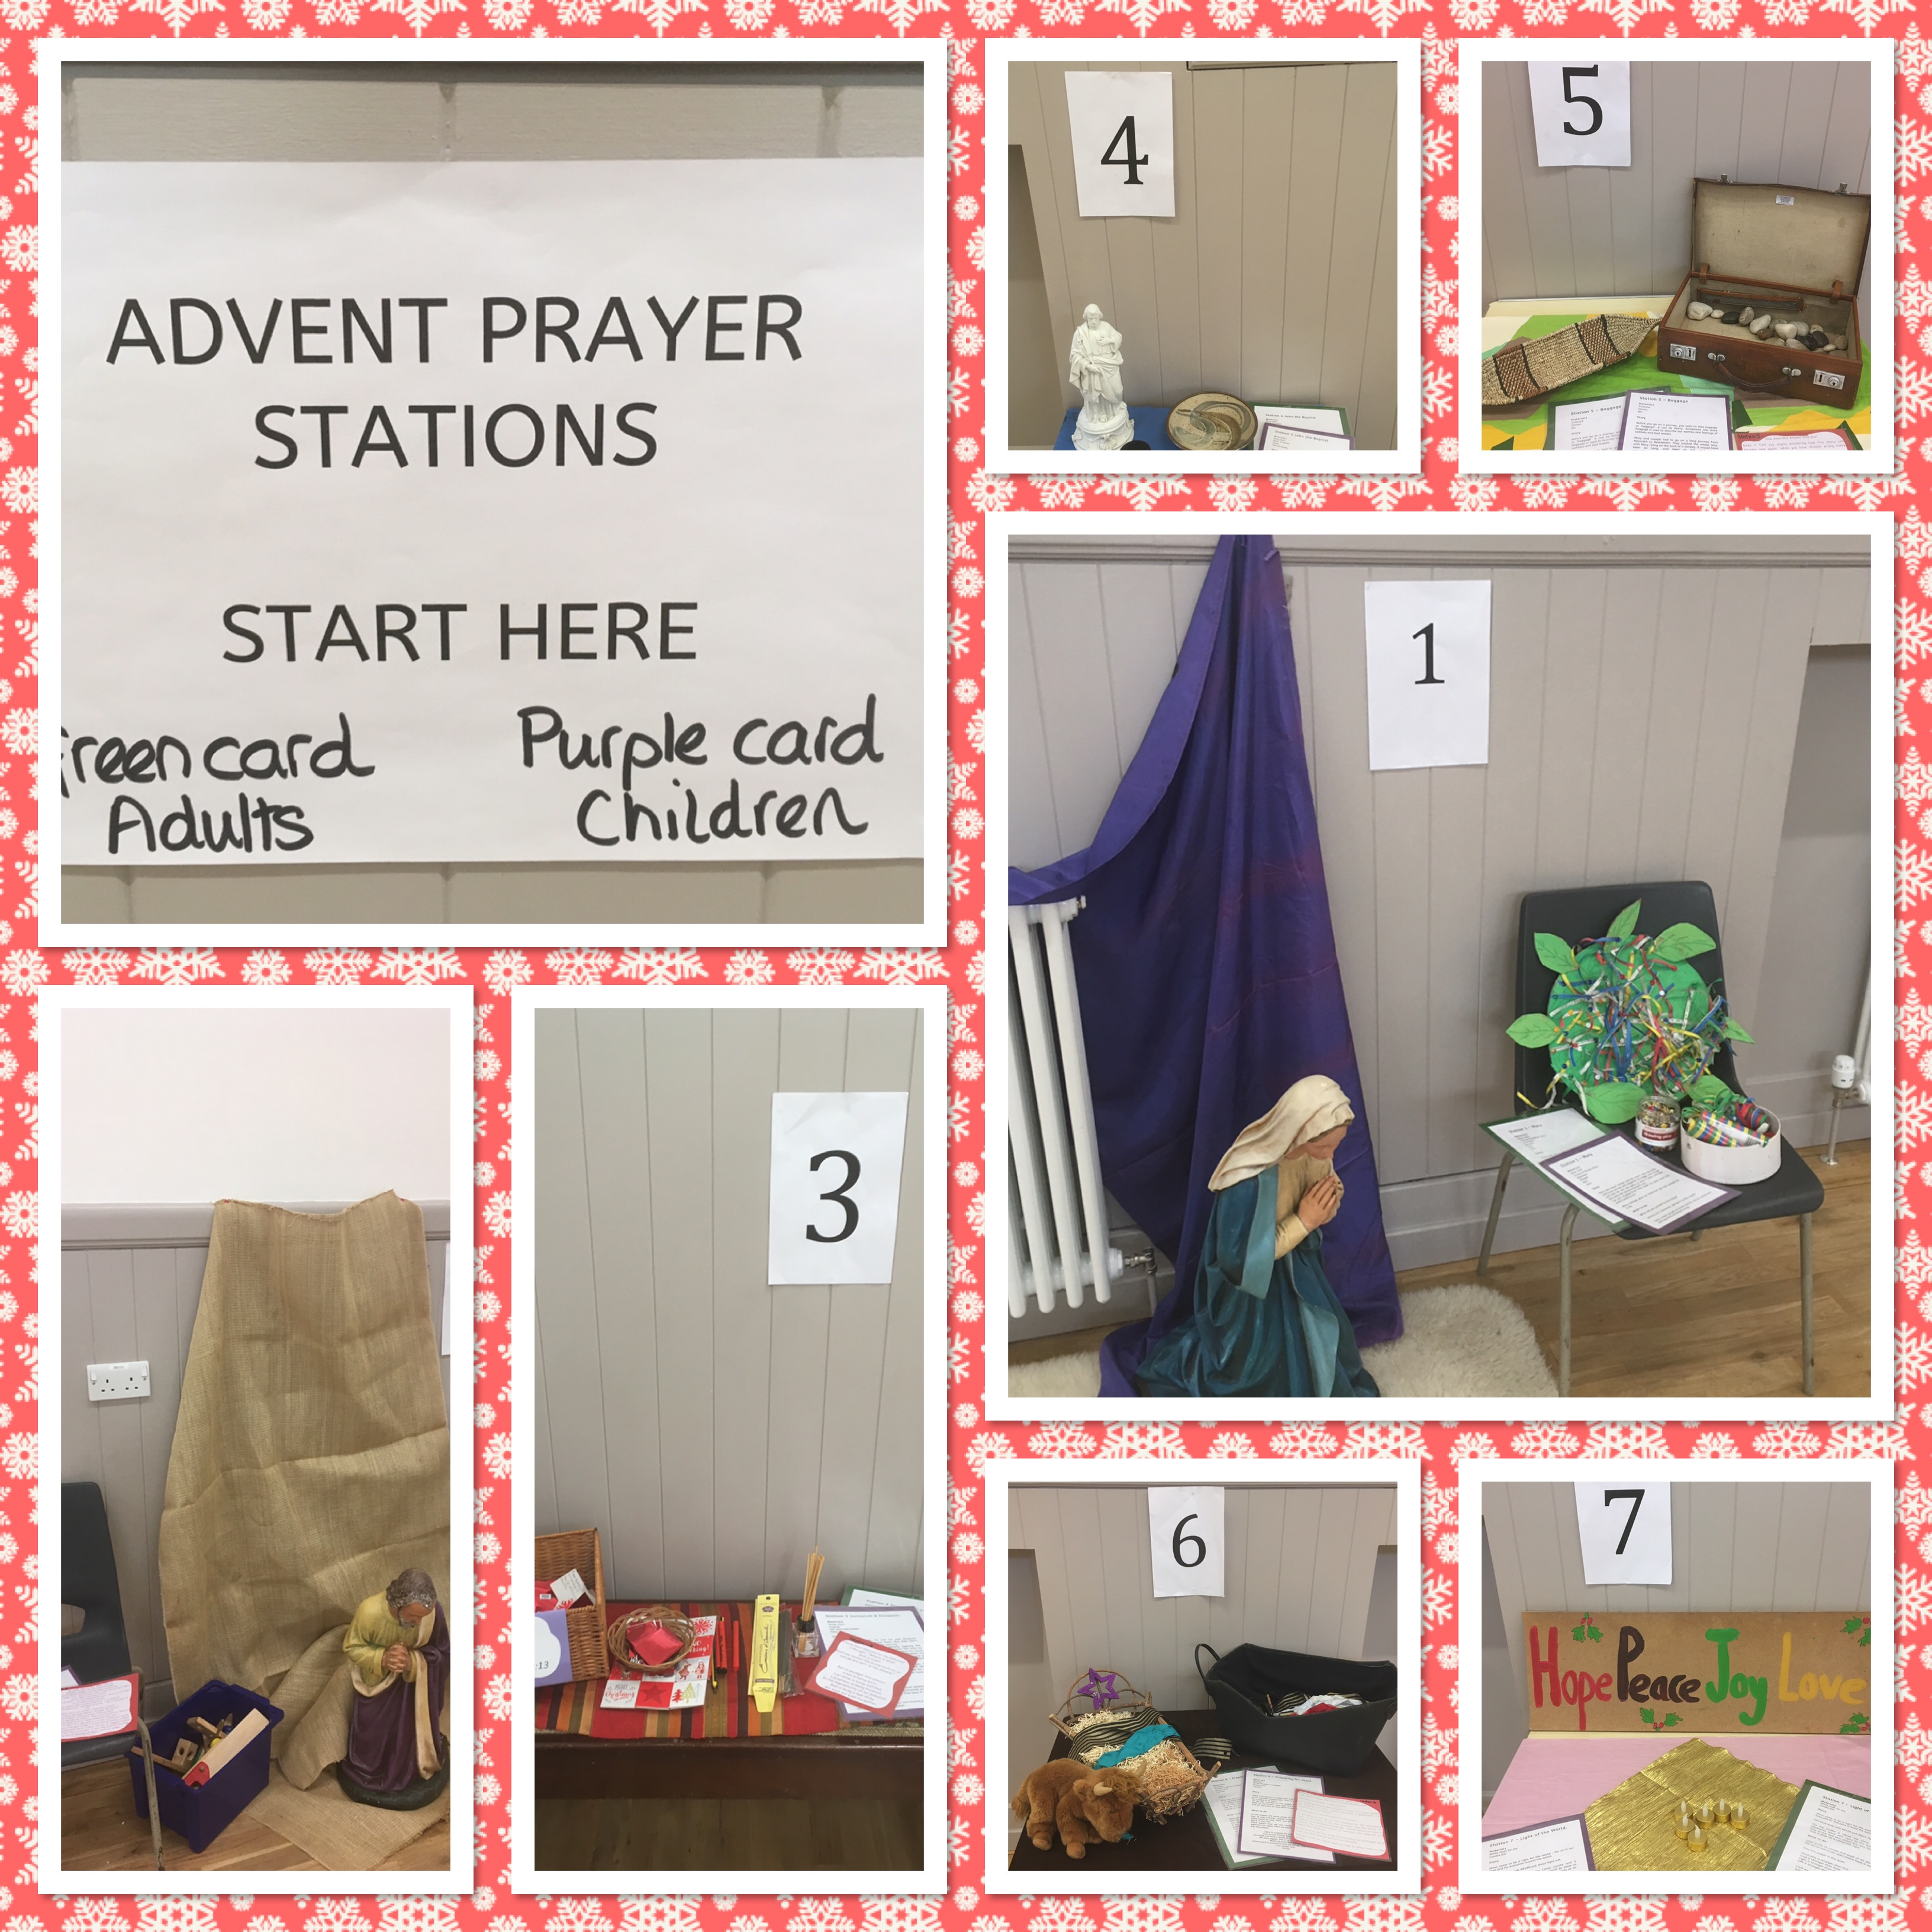
Advent Prayer Stations
The story of Christmas

Slide 7
How Prayer Stations work
We have prayer stations in the chapel now every September
We have had a ‘love’ theme and also a theme of the ‘I am’ statements.
We have prayer stations in the chapel every Advent and Lent season too.
They are available for a ¾ week period, and classes sign up on a time table each week.

Slide 8
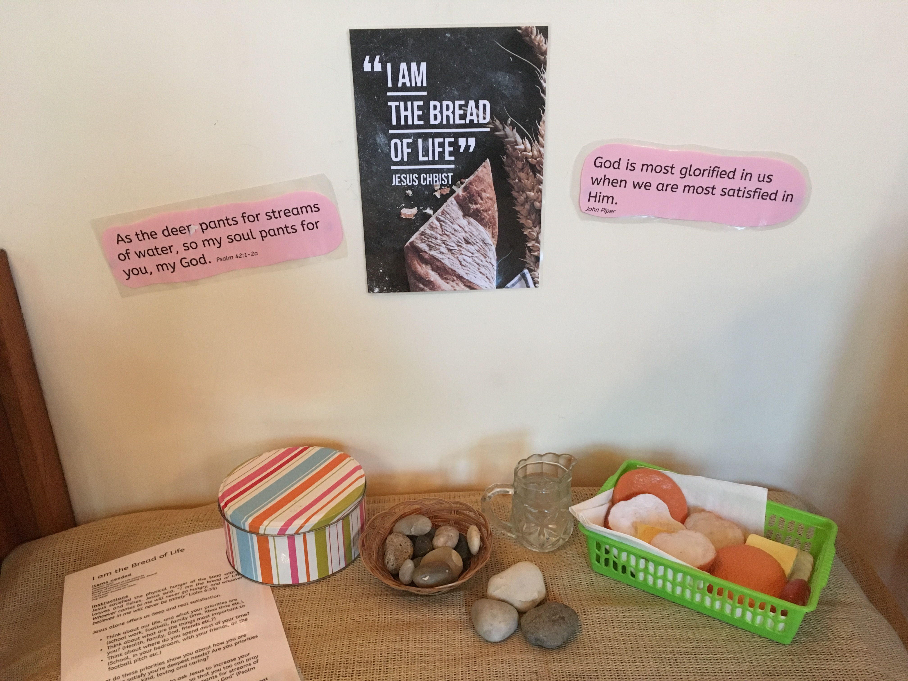
Picture of a prayer station

Slide 9
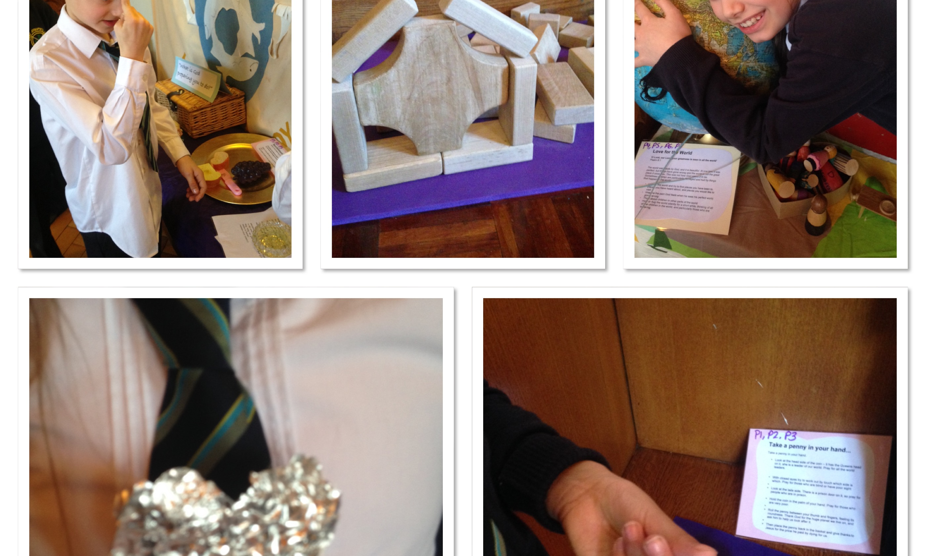
Lent prayer stations

Slide 10
Example of a station
We are all different, we all have different things going on in our lives, and these button prayers will help you focus on prayers specific to you.
Instructions
Take a button and hold it, and read the following prompts-
Feel the hardness of the button and think about some one you know going through hard times. Ask God to help them.
Buttons are used to fasten clothes together. Ask God to bring together people you have fallen out and moved apart from. Pray that he will bring peace and bring you back together.
Look at the button and see how many holes it has. Think of that number of things you would like to say thank you to God for.
Look at the colour of the button and say Thank you to God for something that is that colour.
Place the button back in the box.

Slide 11
Feedback from children
“I like how you can pray using different things like chains, lego, sand, my favourite was the penny” Samuel
‘I like to go the chapel for prayer stations, it is very peaceful, seeing the whole class, moving around praying at each station’ Sophie
‘the prayer stations make us think about saying prayers differently than the way we say them in class or in church’ Zuzia

